Slide 1
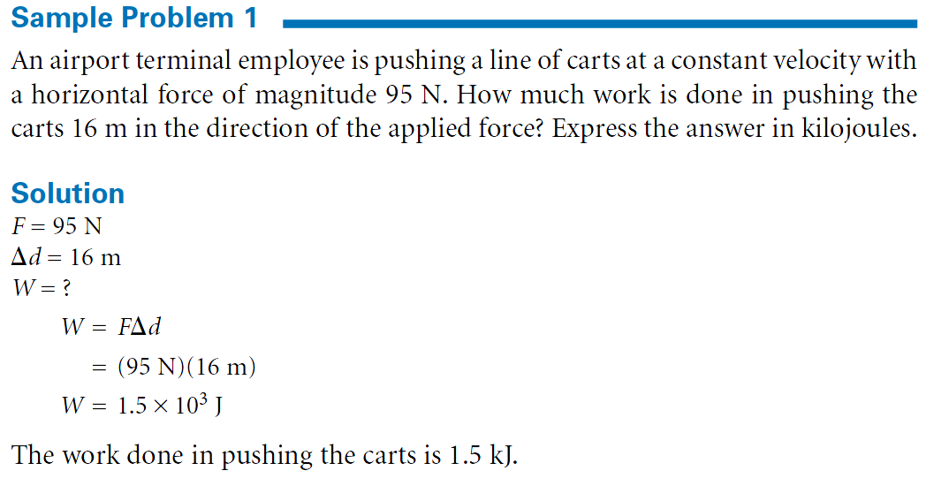

Slide 3
When Work Is Done
Condition | Work Done | Example

Slide 4
Sample Problem
A 0.1 Kg arrow is fired through a 0.9 m foam target and slows from a velocity of 100 m/s to 80 m/s in 0.01s.
What type of work is done?
How much work is done?
What is the acceleration
What is the force
What is the distance
What is the work

